Slide 1
Introduction to Data Structures
By-
Dr. Shweta R. Malwe
Assistant Professor
Area of CSE

Slide 2
Basic Terminologies
Data Structure
  Data: a value or set of values of different type which is called data types like string, integer, char etc.
  Structure: Way of organizing information, so that it is easier to use.

Slide 3
Definition
Data structure is representation of the logical relationship existing between individual elements of data.
In other words, a data structure is a way of organizing all data items that considers not only the elements stored but also their relationship to each other.

Slide 4
Introduction
Program = Algorithm + Data Structure
Algorithm is a step by step procedure to solve a particular function.

Slide 5
Classification of Data Structure
Data structure are normally divided into two broad categories:
  Primitive Data Structure
  Non-Primitive Data Structure

Slide 6
Classification of Data Structure
Data structure
Primitive DS
Non-Primitive DS
Integer
Float
Character
Pointer
Integer
Float
Float

Slide 7
Classification of Data Structure
Non-Primitive DS
Linear DS
Non-Linear DS
Array
Queue
Graph
Trees
Linked List
Stack

Slide 8
Primitive Data Structure
There are basic structures and directly operated upon by the machine instructions.
Integer, Floating-point number, Character constants, string constants, pointers etc, fall in this category.

Slide 9
Non-Primitive Data Structure
There are more sophisticated data structures.
These are derived from the primitive data structures.
The non-primitive data structures emphasize on structuring of a group of homogeneous (same type) or heterogeneous (different type) data items.

Slide 10
Operations in a Data Structure
Traversing: accessing each record/node exactly once so that certain items in the record may be processed.
Inserting: Adding a new node/record to the structure.
Deleting: Removing a node/record from the structure.
Searching: Finding the location of the desired node with a given key value.

Slide 11
Non-Primitive Data Structure
Commonly used operation on data structure are :
  Creation
  Selection
  Updating
  Searching
  Sorting
  Merging
  Deletion

Slide 12





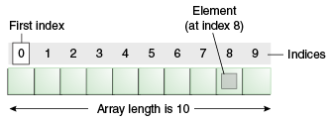
Description of various Data Structures : Arrays
An array is defined as a set of finite number of homogeneous elements or similar data items.

Slide 13
Linked Lists
A Linear linked list can be defined as a collection of variable number of data items.
Lists are the most commonly used non-primitive data structures.

Slide 14




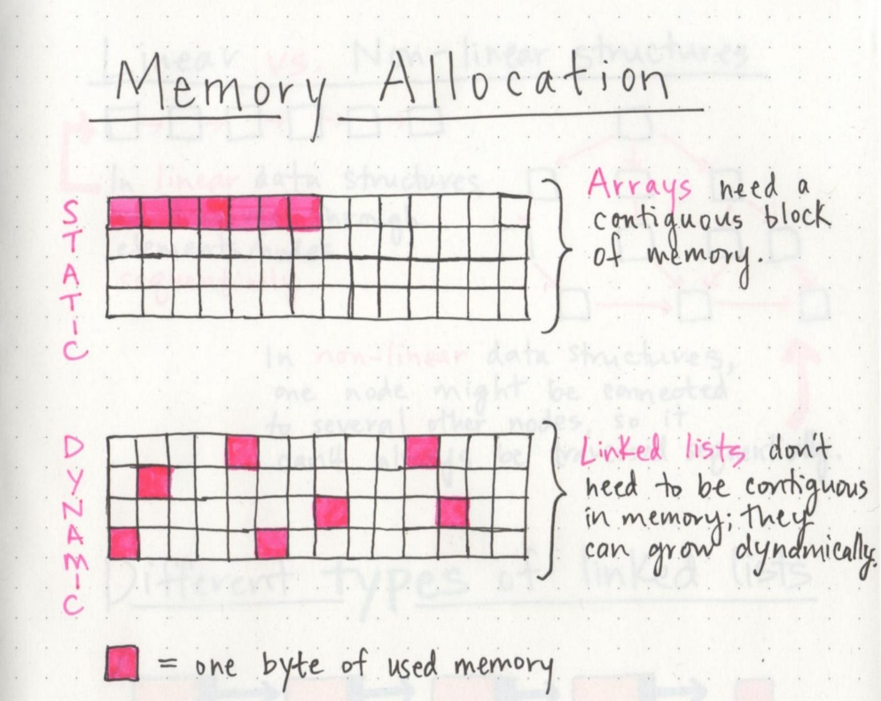



Slide 15

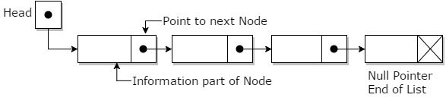










Linked List

Slide 16




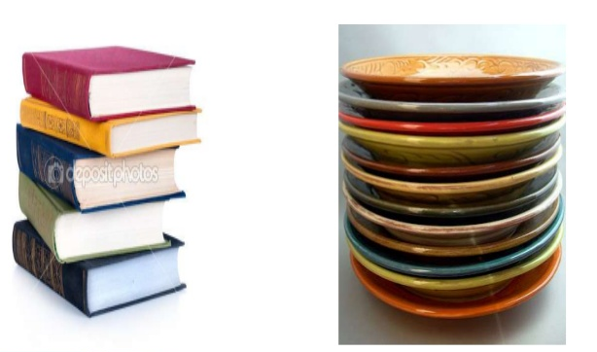






Stack

Slide 17
Stack
A stack is also an ordered collection of elements like arrays, but it has a special feature that deletion and insertion of elements can be done only from one end called the top of the stack (TOP)
Last In First Out type of data structure (LIFO).

Slide 18
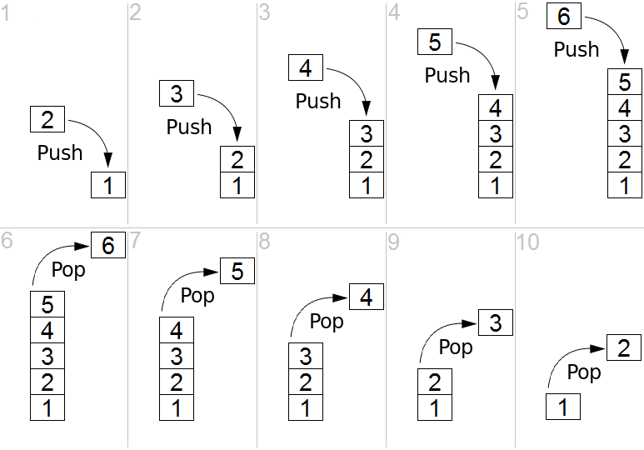


Slide 19









Stack
The stack can be implemented into two ways:
  Using arrays (Static implementation)
  Using pointer (Dynamic implementation)

Slide 20

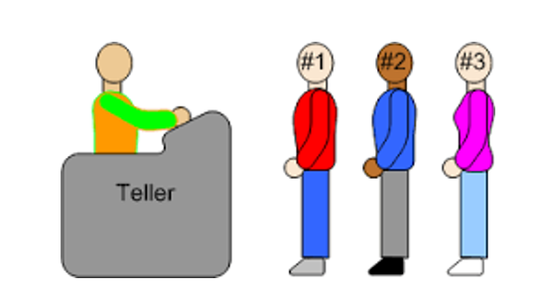








Queue
10 | 20 | 30 | 40 | 50
front
rear

Slide 21
Queue
Queue are first in first out type of data structure (i.e. FIFO)
In a queue new elements are added to the queue from one end called REAR end and the element are always removed from other end called the FRONT end.
The people standing in a railway reservation row are an example of queue.

Slide 22








Queue
The queue can be implemented into two ways:
  Using arrays (Static implementation)
  Using pointer (Dynamic implementation)

Slide 23


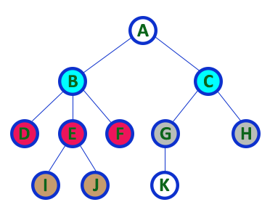


Trees

Slide 24
Trees
Tree is non-linear type of data structure.
It is mainly used to represent data containing a hierarchical relationship between various elements.

Slide 25
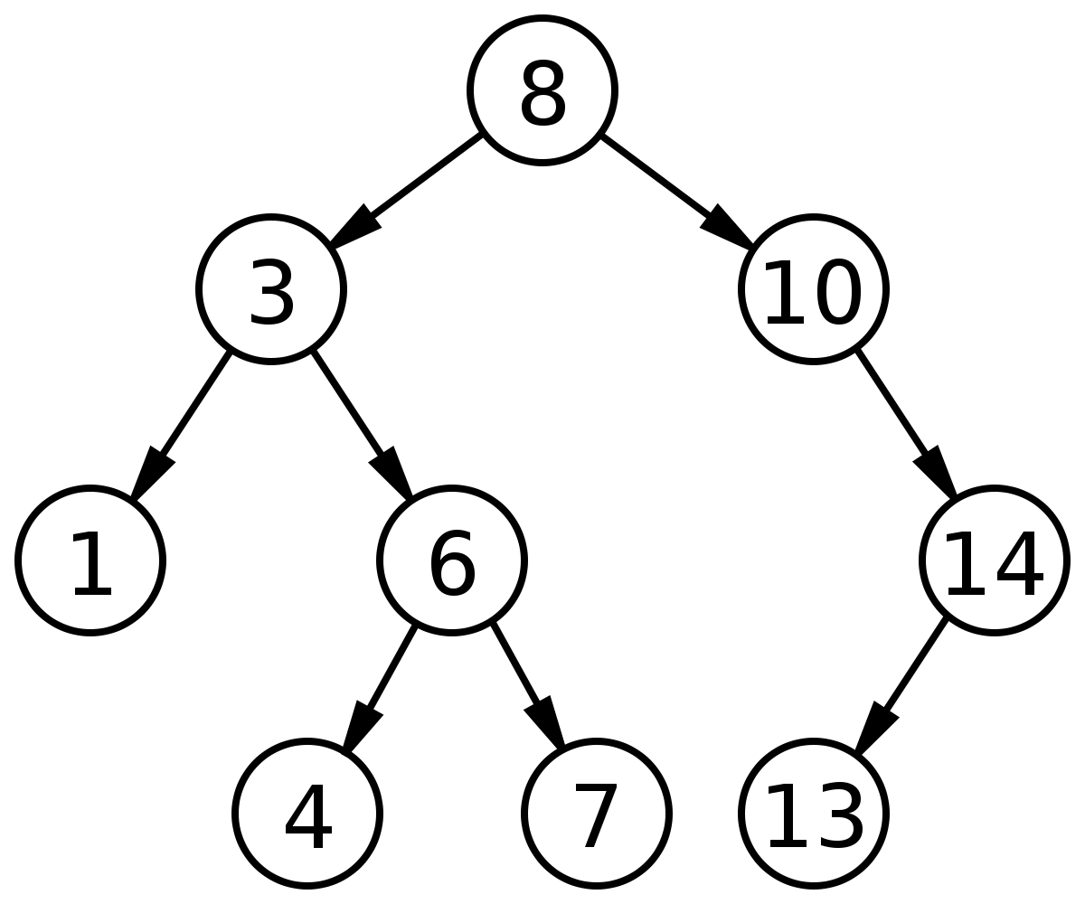
Binary Tree

Slide 26
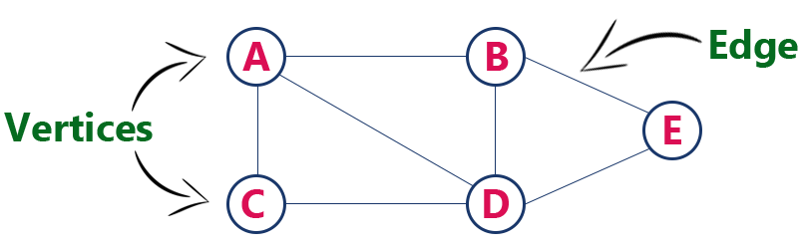
Graph

Slide 27
Graph
Graph is a mathematical non-linear data structure capable of representing many kind of physical structures.
Definition: A graph G (V, E) is a set of vertices V and a set of edges E.

Slide 28
Graph
Example of graph:
6
v2
v5
v1
v3
10
v1
8
11
15
9
v2
v3
v4
v4
v4
[a] Directed & Weighted Graph
[b] Undirected Graph

Slide 29
Selecting a Data Structure
Analyse the problem
Determine resource constraints
Determine basic operations
Select the data structure

Slide 30
Thank You

